Slide 1

Analyzing Technology Skills & Trends
By: Vayank Paliwal
March 3, 2025

Slide 2



OUTLINE
Executive Summary
Introduction
Methodology
Results
Visualization – Charts
Dashboard
Discussion
Findings & Implications
Conclusion
Appendix

Slide 3

EXECUTIVE SUMMARY
Point1
Point2
Sub Point 1
Sub Point 2
Sub Point 3
Point3
Point4
Point5

Slide 4

INTRODUCTION
Point1
Point2
Point3
Point4
Sub Point1
Sub Point2

Slide 5

METHODOLOGY
Point1
Point2
Point3
Point4
Sub Point1
Sub Point2

Slide 6
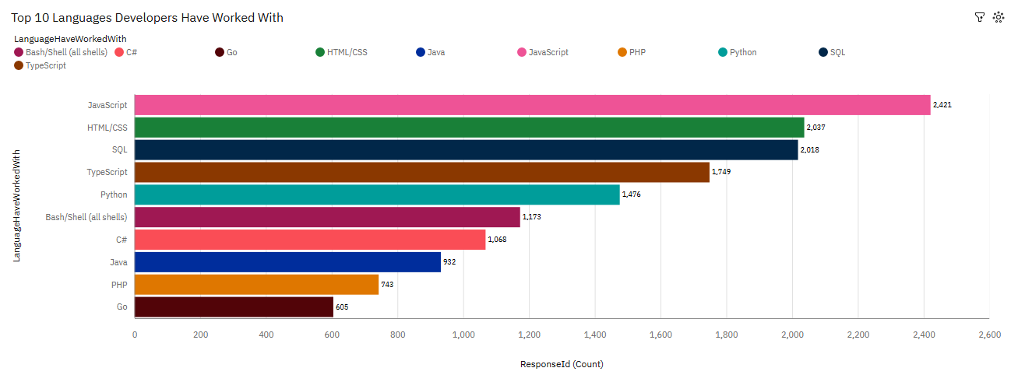
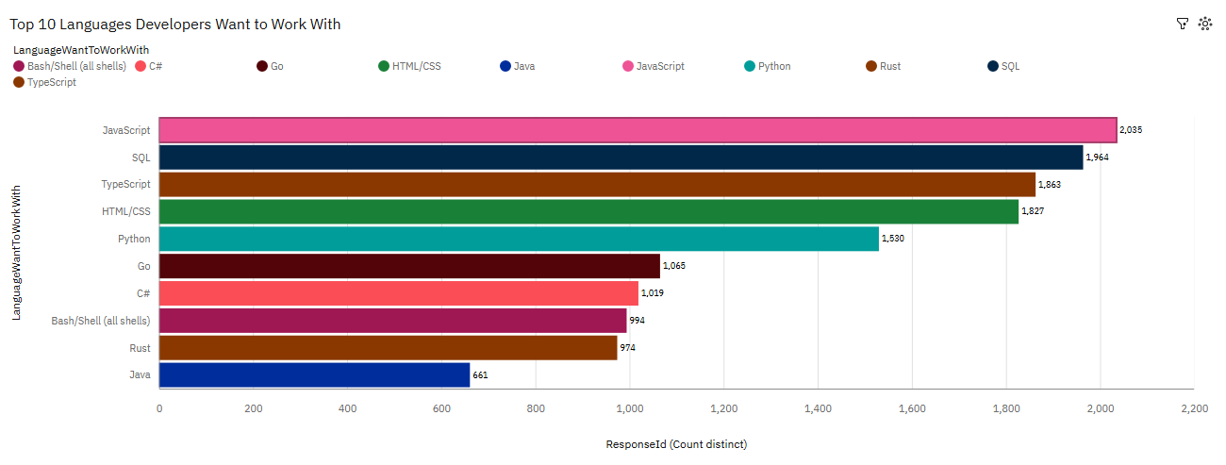
PROGRAMMING LANGUAGE TRENDS
Current Year
Next Year
<Bar chart of top 10 programming languages for the current year goes here.>

Slide 7
PROGRAMMING LANGUAGE TRENDS - FINDINGS & IMPLICATIONS
Findings
JavaScript is the most commonly worked-with language and the most desired language developers want to work with.
SQL is among the top languages developers have worked with and want to work with.
Languages with strong job demand (JavaScript, SQL, Python) will continue to dominate.
Implications
JavaScript’s significance in web development and full-stack applications, making it a crucial skill for developers.
SQL is a vital skill for backend and full-stack developers
Some traditional languages (Java, Bash) are still relevant but may not be as appealing to new developers.

Slide 8
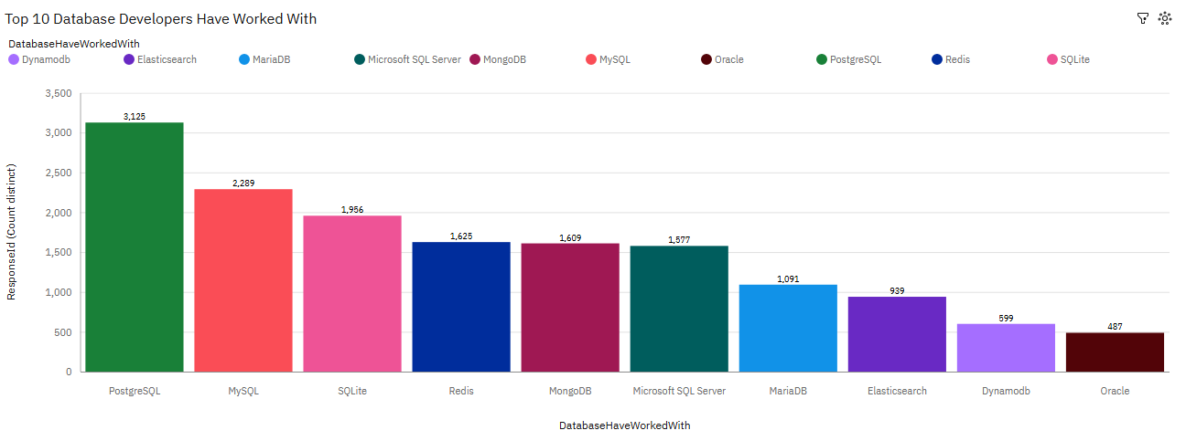
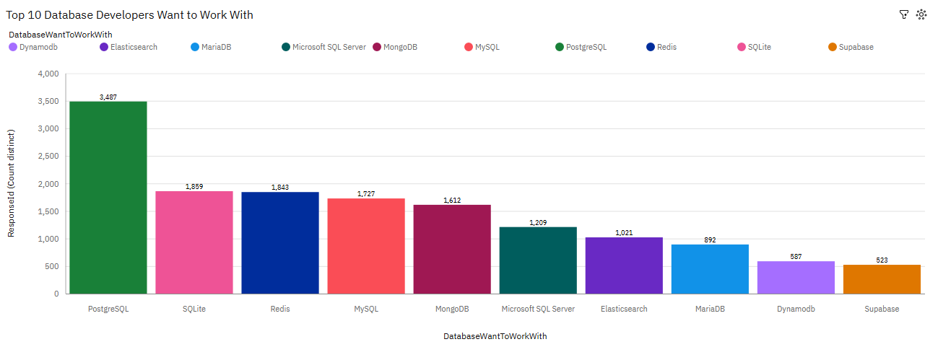
DATABASE TRENDS
Current Year
Next Year

Slide 9
DATABASE TRENDS - FINDINGS & IMPLICATIONS
Findings
Finding 1
Finding 2
Finding 3
Implications
Implication 1
Implication 2
Implication 3

Slide 10

DASHBOARD

Slide 11
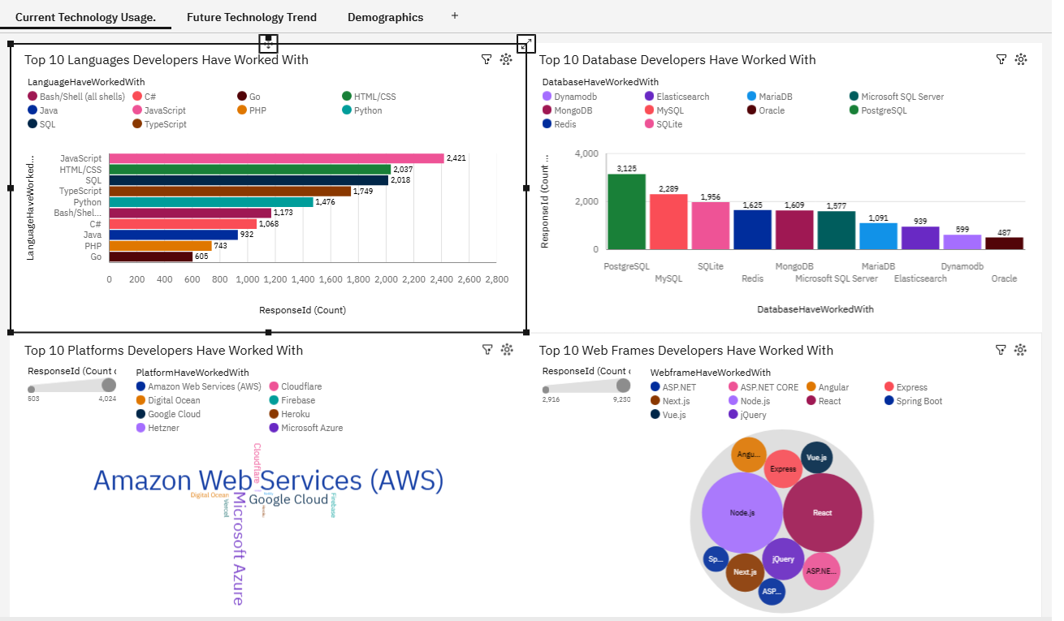
Current Technology Usage

Slide 12
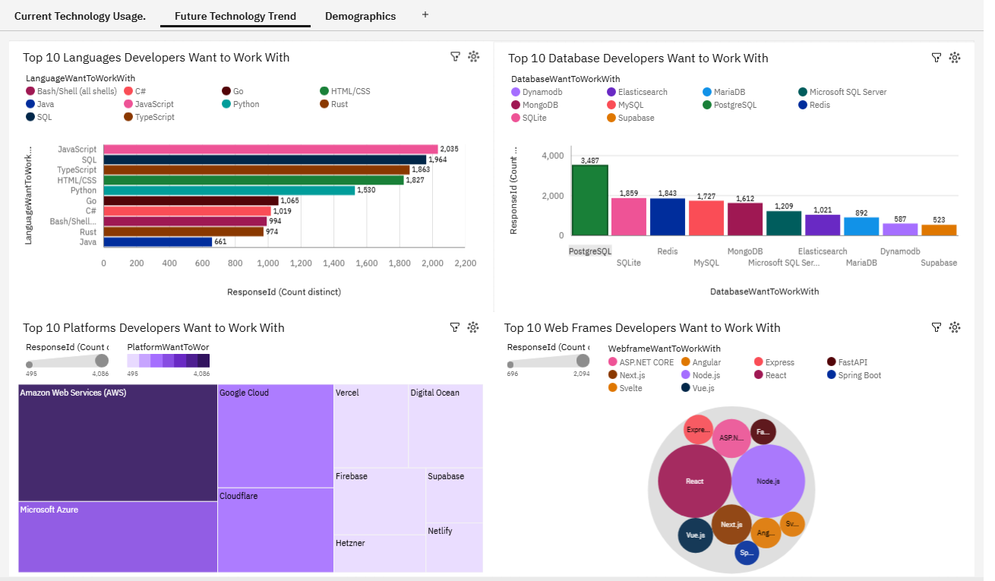
Future Technology Usage

Slide 13
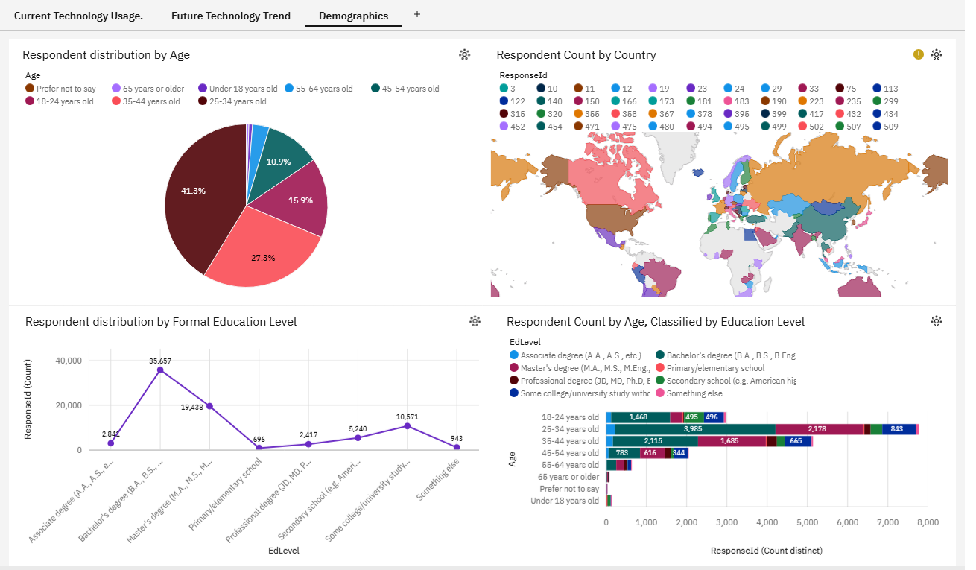
Demographics

Slide 14
DISCUSSION

Slide 15
OVERALL FINDINGS & IMPLICATIONS
Findings
Finding 1
Finding 2
Finding 3
Implications
Implication 1
Implication 2
Implication 3

Slide 16

CONCLUSION
Point 1
Point 2
Point 3
Point 4

Slide 17

APPENDIX
Include any relevant additional charts, or tables that you may have created during the analysis phase.

Slide 18
JOB POSTINGS
In Module 1 you have collected the job posting data using Job API in a file named “job-postings.xlsx”. Present that data using a bar chart here. Order the bar chart in the descending order of the number of job postings.

Slide 19
POPULAR LANGUAGES
In Module 1 you have collected the job postings data using web scraping in a file named “popular-languages.csv”. Present that data using a bar chart here. Order the bar chart in the descending order of salary.

